Slide 1
Business to Social Cohesion
October 2021

Slide 2
Business to Social Cohesion
Project Overview
Duration: 12 months
Budget: 1,110,427 $
Implementing Partner: Ministry of Industry and Technology
Directorate General of Development Agencies
Project Donor: Government of Japan

Slide 3
Business to Social Cohesion
Aim of the Project
Aim of the Project;
Supporting women’s cooperatives and women entrepreneurs, eliminating the negative effects of COVID-19 and ensuring that the target group’s work recovered/ getting better (build back better)
Supporting social cohesion by increasing the participation of Syrian refugees and host community members in socio-economic life and self-sufficiency.
The project will focus on women entrepreneurs and women’s cooperatives.

Slide 4
Business to Social Cohesion
Project Outputs and Activities
Output 1 – Increasing the Resilience of Cooperatives
Output 2 –Increasing women’s access to the labour market through entrepreneurship
Consultancy services for 40 women’s cooperatives regarding their needs,
Providing in-kind support for the needs arising from consultancy services,
Taking initiatives in the presence of local, regional and international supply chains, e-commerce platforms and potential buyers in target provinces in order to develop the commercialization and sales channels of the supported cooperatives,
Inventory study and establishment of online platform for commercialization and promotion of local products.
Organizing 3 Bootcamp organizations for 75 women entrepreneurs and women’s cooperatives,
Providing consultancy services to 25 women’s cooperatives participating in the Bootcamp and subsequently providing in-kind support,
Providing consultancy services to 20 women entrepreneurs/ cooperatives participating in the Bootcamp and subsequently providing in-kind support,
Taking initiatives in the presence of local, regional and international supply chains, e-commerce platforms and potential buyers in target provinces in order to develop the commercialization and sales channels of supported women entrepreneurs and women’s cooperatives.
Notes:
Çalışma izinleri, dijitalleşme, e-ticaret, paketleme, standardizasyon, laboratuar hizmetleri, çalışma izinleri, vb.

Slide 5
Business to Social Cohesion
Target Group and Provinces
Target Group 1:
40 women’s cooperatives established by host community members and Syrians
Target Group 2:
75 women entrepreneurs and women’s cooperatives
Target Provinces/Regions:
Bingöl, Elazığ, Malatya, Tunceli
Artvin, Giresun, Gümüşhane, Rize, Trabzon, Ordu
Çankırı, Kastamonu, Sinop
Aydın, Denizli, Muğla
Antalya, Burdur, Isparta
Aksaray, Kırıkkale, Kırşehir, Nevşehir, Niğde
Kayseri, Sivas, Yozgat
Gaziantep, Adıyaman, Kilis
Diyarbakır, Şanlıurfa
Mardin, Şırnak, Siirt, Batman
Target Provinces:
Mersin, Hatay, Gaziantep, Adana, Şanlıurfa, Kahramanmaraş
Sivas, Yozgat, Konya, Kayseri, Nevşehir
İzmir, Manisa, Aydın, Denizli, Muğla

Slide 6
Business to Social Cohesion
Expected Outcomes
Output 1: Increasing the Resilience of the Cooperatives
40 women’s cooperatives will benefit from consultancy services and in-kind support to reduce the negative effects of COVID-19 on business and sales processes,
Cooperatives and local producers will commercialize their products and integrate into local, regional and/or international supply chains,
The online platform to be developed will facilitate the promotion and commercialization of local products and the process of supporting local producers,

Slide 7
Business to Social Cohesion
Expected Outcomes
Output 2: Increasing women’s access to the labour market through entrepreneurship
75 women entrepreneurs and women’s cooperatives will participate in the Bootcamp program from refugees and host community members, to develop their business plan,
Consultancy services and in-kind support will be provided to 25 women’s cooperatives participating in the Bootcamp to improve their businesses,
20 women entrepreneurs/women’s cooperatives participating in the Bootcamp will be provided with consultancy services to establish and develop their businesses, and in-kind support also will be provided within the framework of the needs identified during the consultancy services,
Women’s cooperatives and women entrepreneurs will be integrated into local, regional and/or international supply chains.

Slide 8
Business to Social Cohesion
In-kind Support Distribution for Beneficiaries
Output 1:
In-kind support to 40 women’s cooperatives, in amount of 1,750 USD per co-op
Output 2:
In-kind support to 25 women’s cooperatives, in amount of 1,750 USD per co-op,
In-kind support to 20 women entrepreneurs/women’s cooperatives, in amount of 4,250 USD per entrepreneur/cooperative

Slide 9
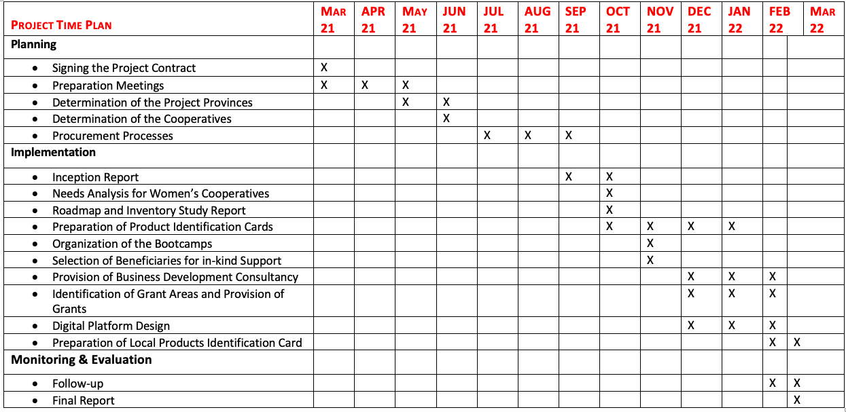
Business to Social Cohesion
Project Timeline

Slide 10
Business to Social Cohesion
Thank you…

