Slide 1
Leave Management – New Role and Responsibility of the Leave Monitor and eServices enhancements
Majbritt Linneberg and Thomas Gilmartin, GSSU/BMS/UNDP

Slide 2
Agenda
Leave Monitor - role and responsibilities
The automated Absence Report Card
Leave Monitoring and HR eServices
Status
Enhancements
Advanced Annual Leave
Sick Leave
Home Leave
Paternity Leave
Upcoming enhancements
Service Contract holders and eServices
Where to find more information
Q/A

Slide 3
Leave Monitor responsibilities - before
Before September 2015, the leave monitor:
monitored all absences and collected the requested documentation of requests and approvals
kept all requests and approvals on file and was main responsible for keeping all files audit proof
maintained the manual Attendance Record Card and ensured the monthly sign-off for all staff
entered the approved requests in Atlas and was focal point for troubleshooting any issue pertaining to incorrect leave balances
informed newcomers about their leave entitlements and responded to queries

Slide 4
Leave Monitor responsibilities - now
Advising | eServices | Monitoring
Inform and train new staff in eServices/My Leave | Entry of leave types not yet in eServices/My Leave | Run the annual report and ensure annual Sign-off
Advise and assist staff upon request | Ensuring correct balances for staff transferred, seconded or separated | Ensuring documentation is kept on file for leave types not yet in eServices/My Leave
Proactively advise staff wherever appropriate | Trouble shoot in case of one-time needs for balance adjustments | Informing management if issues on leave

Slide 5
Leave Monitor responsibilities
Leave records are, with immediate effect, exclusively maintained in eServices/Atlas.
Implications:
The monthly sign-off and the manual Attendance Record Card are abandoned
Physical leave files are reduced to include the requests and approvals of leave types not yet in eServices and will ultimately be out-phased
Leave monitoring and leave management are the responsibility of the staff member and the supervisor; the leave monitor is notified when leave is approved/rejected/cancelled or if needed to verify the balance
The Leave Monitor will ensure an annual sign-off applying the automated report generated in Atlas HCM.

Slide 6
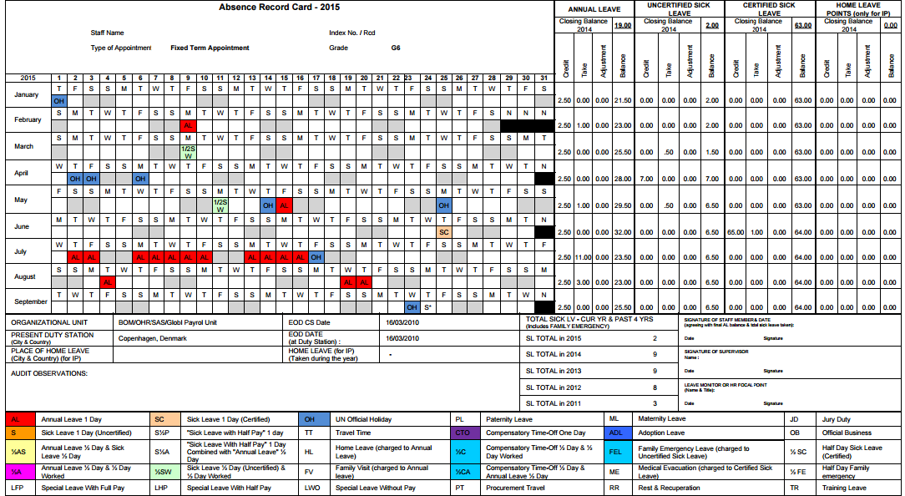
New Absence Report Card in ATLAS
In Atlas you are now able to pull the Absence Report Card as a UN Report.

Slide 7
ATLAS Absence Report Card – New features
The new Absence Report Card will facilitate the role and the responsibility of the Leave Monitor as this includes, in addition to the manual Attendance Record Card, valuable information regarding:
Accumulated absence balances
Adjustments done, which and when
Sick Leave information with 4 years retro-activity
Home leave point – balance and accumulation
Monthly accruals of all above
Who can run the report:
If you have the Leave Monitor Atlas profile, you can print for a single staff member or for all staff members where you are the Leave Monitor.
If you have the HR Atlas profile, you can print for all staff members in a department, location or country.

Slide 8
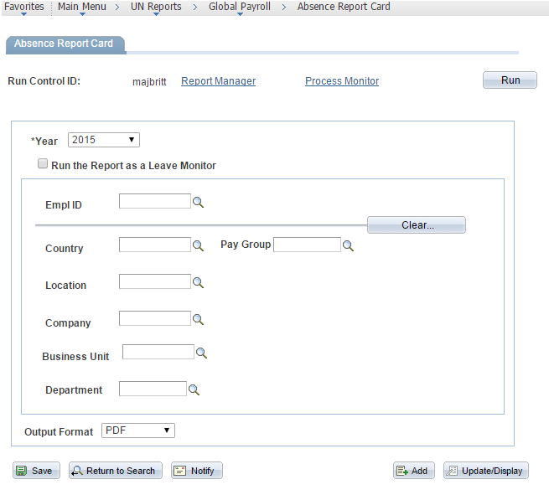
ATLAS Absence Report Card – how to do (1/3)
You can pull the Absence Report Card in the Atlas HR module.
Go to Main Menu/UN Reports/Global Payroll/Absence Report Card and enter the relevant parameters as needed – click ‘Save’ and ‘Run’:
You can enter just Empl ID to run for one staff member, or enter Country or Location if you want to print multiple Report Cards for all in the country or location.
Make sure to pick Output Format PDF.

Slide 9
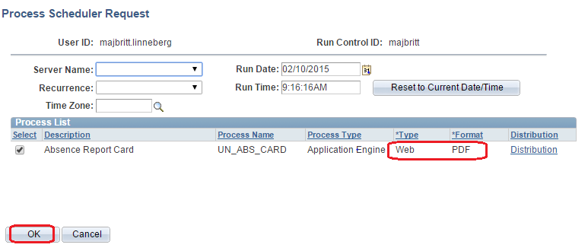
ATLAS Absence Report Card – how to do (2/3)
When you get to the Process Scheduler Request page, make sure to pick Web and PDF, then click OK:
Then click ‘OK’ and the top link click Process Monitor – click ‘Refresh’ until the ‘Distribution Status’ says ‘Posted’ – then click ‘Details’:

Slide 10
ATLAS Absence Report Card – how to do (3/3)
On the Process Detail page, you choose the View Log/Trace:
Her you can open the PDF report including Absence Report Cards for all the staff included in your search:

Slide 11
eServices status September 2015
Leave types fully integrated in eServices/My Leave | Leave types not in eServices/My Leave
Annual Leave Uncertified Sick Leave Family Emergency Leave Certified Sick Leave Special Leave Paternity Leave Maternity Leave Home Leave | Compensatory Time Off (for OT) Compensatory Day Off (for travel) Jury Duty Leave Rest and Recuperation Adoption Leave Education Grant Travel Family Visit Official Business
Leave types to be launched in eServices/My Leave shortly:
R&R
Jury Duty
Compensatory Day/Time Off
Official Business

Slide 12
eServices Approval Workflow
Approval Workflow
The approval process depends on the absence type:
Automatic Approval: Uncertified Sick Leave
1 Step Approval: Annual Leave, Family Emergency Leave, Certified Sick Leave
2 Step Approval: Special Leave, Paternity/Maternity Leave, Home Leave

Slide 13
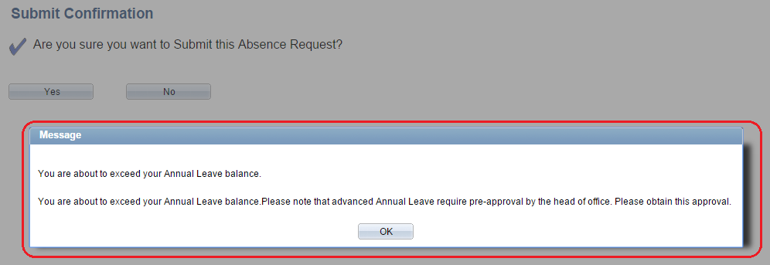
eServices – enhancements – Advanced Annual Leave
When applying for advanced Annual Leave, both staff member and approver will be notified:

Slide 14
eServices – enhancements – Advanced Annual Leave
How Atlas calculates Advanced Annual Leave:
The calculation of the Annual Leave balance takes into account the leave entitlement, which the staff member accrues every month; e.g. for staff on FTA contracts 2.5 days every month and TA contracts 1.5 days every month.
Example: If a staff member has a balance of 9 days and apply for 10 days in the next month, it will not be considered advanced Annual Leave and the staff member will not receive a warning.
The leave period is for 10 days, but in the month the staff takes the leave, the balance will be 9 days + 2.5 days = 11.5 days.
It is possible to click ‘OK’ to the warning. It is not a ‘show-stopper’.

Slide 15
eServices – enhancements – Sick Leave
Sick Leave balances and notifications
The Sick Leave module has been updated in order to strengthen Sick Leave management in regards to the requirement that a staff member, who is unable to perform his or her duties by reason of illness or injury, must submit a medical certificate or a medical report to UN Medical Services, no later than the twentieth working day following the initial absence from duty.
Uncertified Sick Leave - Balance
When a staff member applies for Uncertified Sick Leave, the current balance will appear in the window. This can also be viewed by the supervisor:

Slide 16
eServices – enhancements – Sick Leave
Certified Sick Leave – take
When a staff member applies for Certified Sick Leave, the number of days taken the last 12 months (not the balance) will appear:
For requests for Certified Sick Leave, the staff member will receive a warning informing him/her about the requirement to submit a medical certificate.

Slide 17
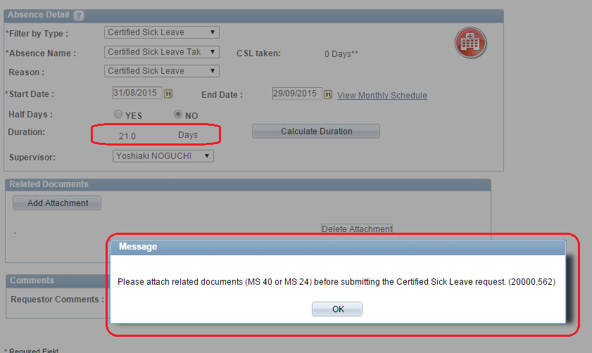
eServices – enhancements – Sick Leave
The system warning the staff member that certification is required.
It is not possible to submit a Certified Sick Leave without attaching a document.

Slide 18
eServices – enhancements – Sick Leave
Email notification to Staff Member if requesting below 20 CSL days:
Subject: Important Notice - This Absence Request has been Submitted
Important Notice: Please note that certified sick leave must be supported by a medical certificate or report from a medical practitioner no later than the twentieth working day following the initial absence. The medical certificate or report should indicate the date or dates of absence by reason of illness, injury or incapacitation, without identification of diagnosis. Please note your supervisor cannot approve a certified sick leave request before the medical certificate or report is submitted. Best regards, Office of Human Resources

Slide 19
eServices – enhancements – Sick Leave
Email notification to Supervisor if SM is requesting below 20 CSL days:
The supervisor will receive similar email requesting him/her to ensure that a medical certificate/report is attached.
Subject: Important Notice - There is an Absence Request awaiting your approval
Important Notice: Please note that certified sick leave must be supported by a medical certificate or report from a medical practitioner no later than the twentieth working day following the initial absence. The medical certificate or report should indicate the date or dates of absence by reason of illness, injury or incapacitation, without identification of diagnosis. Please note a supervisor cannot approve a certified sick leave request before the medical certificate or report is submitted or attached. Best regards, Office of Human Resources

Slide 20
eServices – enhancements – Sick Leave
Email notification to Staff Member if requesting above 20 CSL days:
Subject: Important Notice - This Absence Request has been Submitted
Important Notice: Please note that your certified sick leave – since it exceeds 20 working days cumulatively or consecutively during the last 12 months period - will need to be certified by the UN Medical Services Division according to ST/AI/2005/3 Amendment 1. Therefore, please submit a Sick Leave Certification Request (MS 24) duly completed and signed by the attending physician directly to the UN Medical Services Division only no later than the 20th working day following the first day of the current absence. When the certification is received from UN Medical Services Division please forward the certification to your Supervisor and Leave Monitor. Please note your supervisor cannot approve this leave before the certification is submitted by yourself to your Supervisor and Leave Monitor. Best regards, Office of Human Resources

Slide 21
eServices – enhancements – Sick Leave
Email notification to Supervisor if SM is requesting above 20 CSL days:
The supervisor will receive similar email requesting him/her to wait with the approval before medical certification is received from UN Medical Services.
Subject: Important Notice - There is an Absence Request awaiting your approval
Important Notice: Please note the staff member has been requested to have his/ her sick leave certified by UN Medical Services Division since it exceeds 20 working days cumulatively or consecutively during the last 12 months period. The staff member will need to submit a MS 24 form duly completed and signed by the attending physician directly to UN Medical Services Division no later than the 20th working day following the first day of the absence. Please wait to approve this leave until the staff member has submitted the certification approval from Medical Services Division. Please upload the certification approval to the request if not already done by the staff member. Best regards, Office of Human Resources

Slide 22
eServices – enhancements – Home Leave
Home Leave – automation of travel time
For Home Leave travel, inbound and outbound, staff are granted a fixed amount of travel time not chargeable to annual leave determined on the basis of the most direct flight from the duty station to the place of HL:
one day for each journey of less than 10 hours
two days for each journey of 10 hours or longer but less than 16 hours
three days for each journey of 16 hours or more.
The travel time entitlement is calculated and entered by HR when approving the Home Leave.
Travel time is applied to working days regardless of when travel actual took place, when the staff member opts for the travel lump sum.
The two periods of travel time will automatically be entered and the actual Home Leave period will be adjusted accordingly. The calculation will take into account any weekends and holidays.

Slide 23
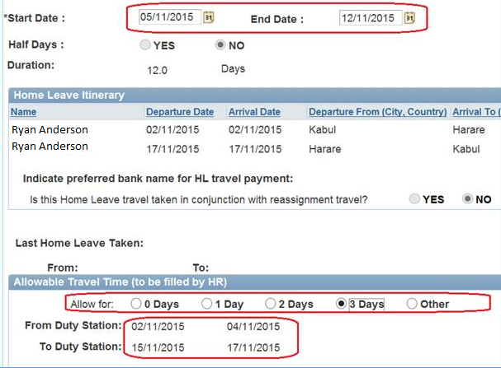
eServices – enhancements – Home Leave
Home Leave – automation of travel time
Example: in the below example, 3 days of travel time is granted. Two periods of travel time is automatically established and the home leave period and the balance is automatically adjusted:

Slide 24
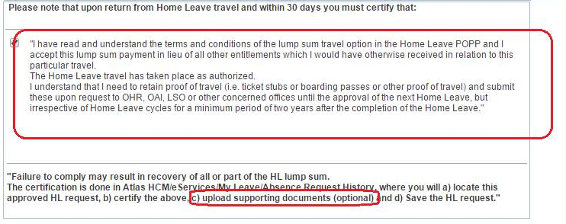
eServices – enhancements – Home Leave
Home Leave Certification - amendment
The staff member must certify that the HL travel has taken place as authorized.
Certification must take place within 30 days upon return from HL travel and the staff member has the option to upload scanned copies of supporting document/boarding passes.
It is not mandatory to upload the supporting documentation, but he/she has the responsibility to retain his/her proof of travel for a minimum period of two years.

Slide 25
eServices – enhancements – Home Leave
Cancelling an approved Home Leave
Previously it was not possible to cancel an already approved Home Leave. It was only possible upon return from the home leave to certify that travel took place as authorized.
It is now possible to cancel and amend a home leave if travel dates changed.

Slide 26
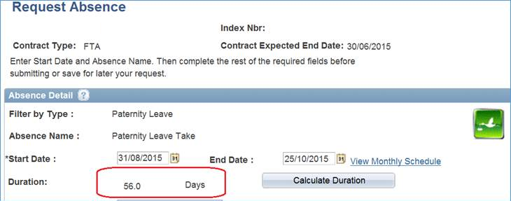
eServices – enhancements – Paternity Leave
Paternity leave consists of up to four weeks of leave with full pay. This is calculated automatically in eServices.
However, for internationally recruited staff members serving at non-family and/or duty stations designated Special Operations Approach (SOA), are eligible for up to eight weeks of paternity leave.
The automatic calculation has been added in eServices and will default to 8 weeks or 56 days.

Slide 27
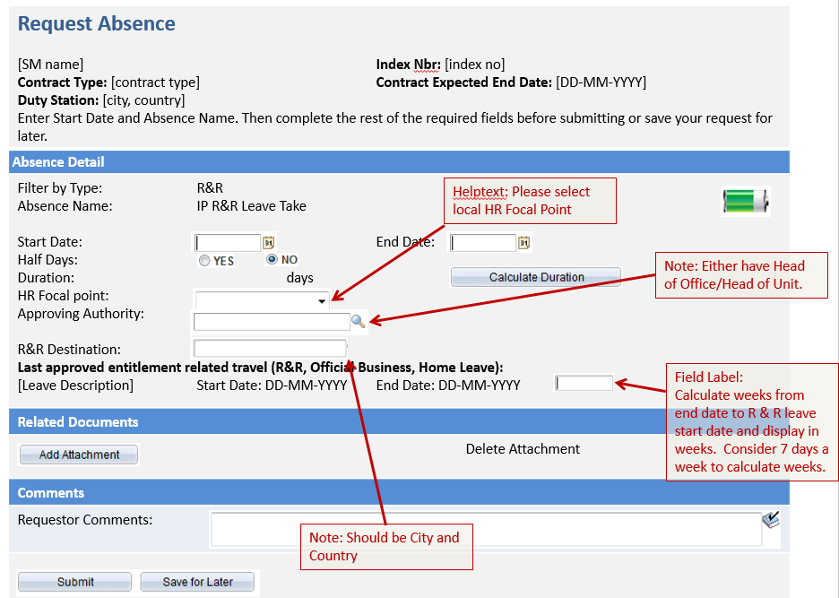
eServices – Future enhancements
OHR and OIST are currently working on implementing R&R, Official Business, Compensatory Day Off (travel), Compensatory Time Off (OT) and Jury Duty Leave in eServices:

Slide 28
eServices – Future enhancements
End of October, the Absence Event page will be linked with eServices.

Slide 29
eServices and Service Contract Holders
The inclusion of Service Contract Holders in eServices was initialized in 2014 with the participation of 10 Country Offices
Following a phased approach, 14 Country Offices joined in September 2015, and another 10-12 Country Offices will be invited to join every month from now on
Pilot project includes Annual Leave only. Inclusion of more leave types is in the making.
Country Office preparations to be done in advance:
Train SCs, supervisors and leave monitors in eServices
Verify the SC Annual Leave balances
Granting of access rights to users

Slide 30
eServices and Service Contract Holders
Pilot Country Offices
2014-2015
2015-2016
No | Region | Country Office
1 | PBAP | Nepal
2 | RBAP | Afghanistan
3 | RBAP | Cambodia
4 | RBAP | Pakistan
5 | RBAS | Lebanon
6 | RBEC | Albania
7 | RBEC | Armenia
8 | RBEC | Kosovo
9 | RBEC | Serbia
10 | RBEC | Uzbekistan
No | Region | Country Office
1 | RBA | Niger
2 | RBA | Uganda
3 | RBA | Ethiopia
4 | RBAP | Vietnam
5 | RBAP | India
6 | RBAP | Sri Lanka
7 | RBAP | Mongolia
8 | RBAS | Somalia
9 | RBAS | Saudi Arabia
10 | RBAS | Iraq
11 | RBEC | Ukraine
12 | RBEC | Montenegro
13 | RBEC | Turkey (TUR and TKY)
14 | RBLAC | Paraguay

Slide 31
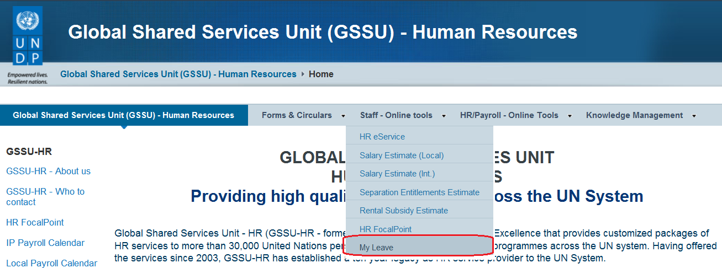
Where to find more information
The POPP has been updated to include eServices/My Leave.
To find more information on eServices/My Leave and the new role of the Leave Monitor, please go to the GSSU Copenhagen website https://info.undp.org/sas/Pages/LEAVE-My-Leave.aspx
Here you will find a comprehensive FAQ section on leave monitoring for both staff and leave monitors including the latest eServices updates and Guidelines for Leave Monitors.

Slide 32
Questions and Answers

